Slide 1

Results of Finetuning by Vladi & Sergei
AWS SageMaker Studio with Jupyter notebook

Slide 2
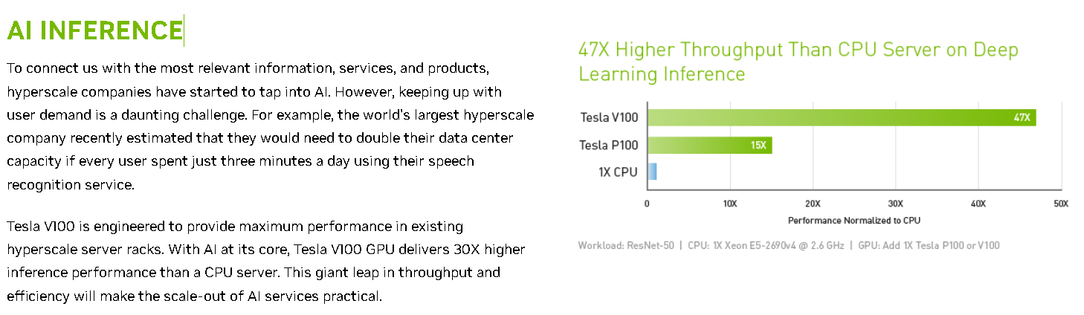
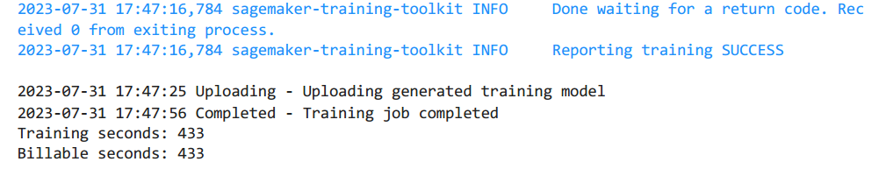
EC2 instance

Slide 3
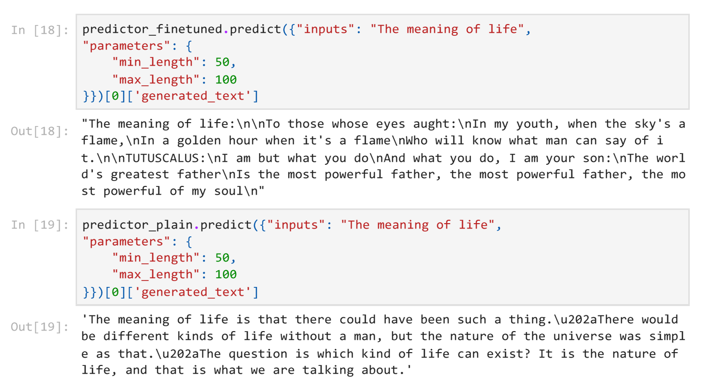

Slide 4
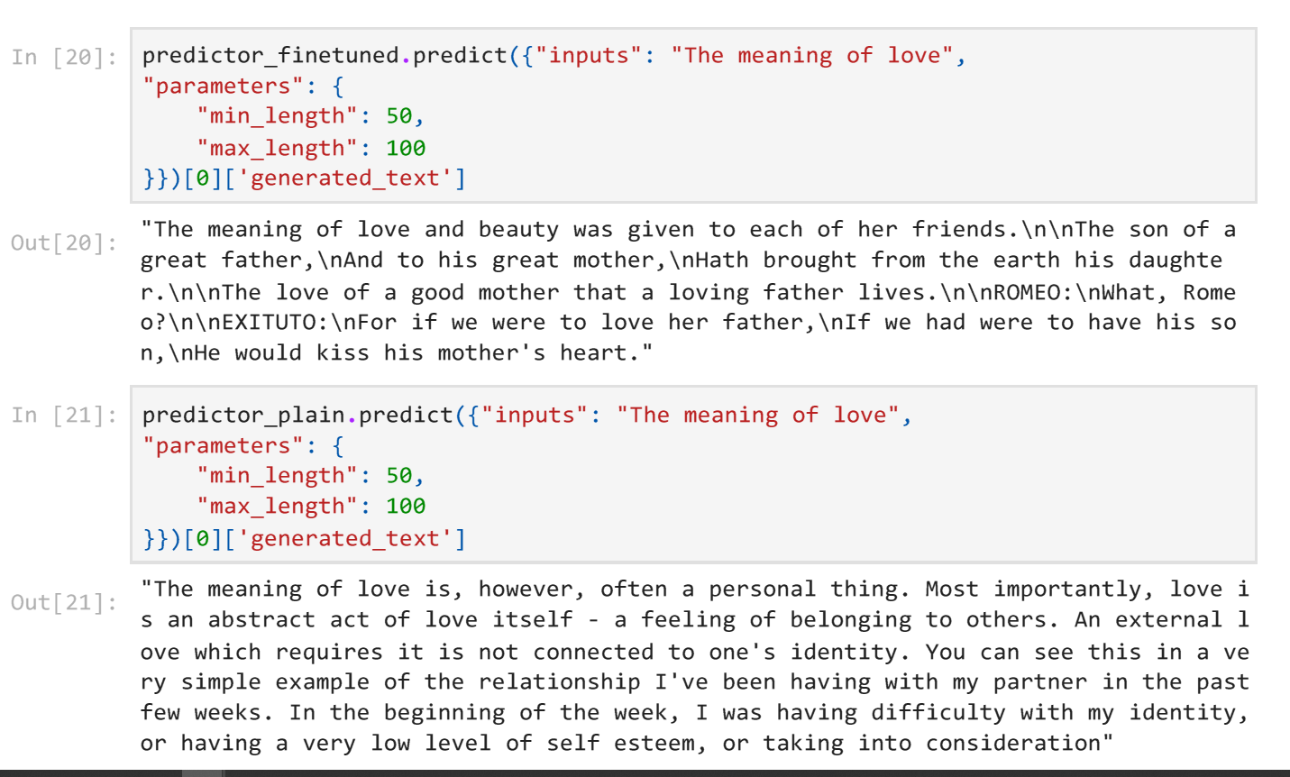

Slide 5
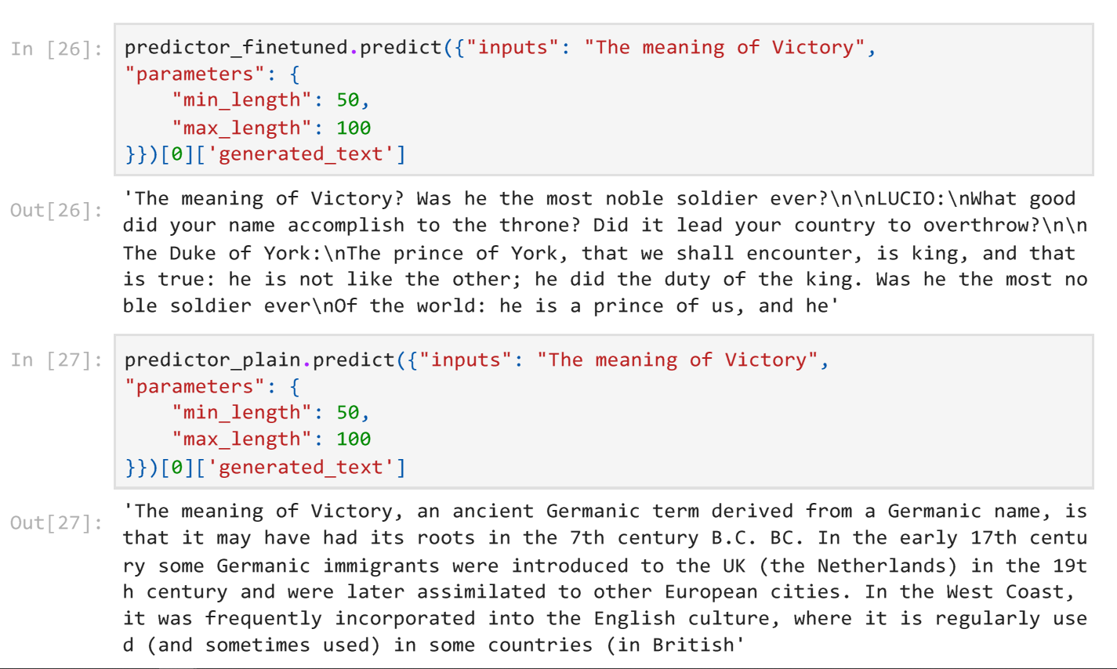

Slide 6
Resources
https://github.com/erezzarum/generative-ai-immersion-day/tree/main/lab2
https://huggingface.co/datasets/tiny_shakespeare
http://karpathy.github.io/2015/05/21/rnn-effectiveness/
https://docs.aws.amazon.com/sagemaker/latest/dg/whatis.html
https://www.nvidia.com/en-gb/data-center/tesla-v100/
https://www.decktopus.com/
https://www.deepbrain.io/
https://temp-mail.org/
To create this presentation, we used: Techsmith Camatsia, Studio, Adobe Photoshop, Adobe Premiere Pro, Adobe Dreamveawer, Microsoft Powerpoint, ChatGPT 2, ChatGPT 3.5, Notepad

